Slide 1

Temporal change of biodiversity in the Anthropocene
Petr Keil

Slide 2
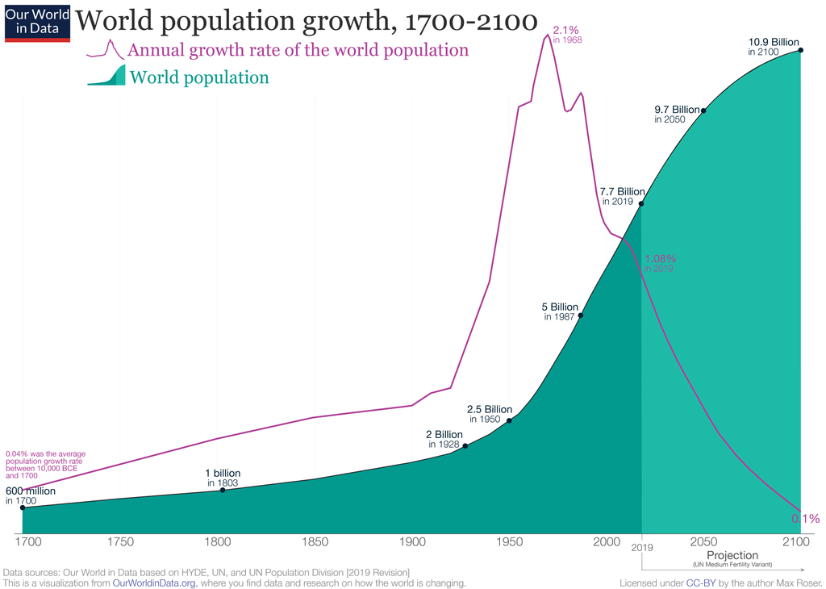
Human population trend and the Anthropocene (a.k.a. the “Age of Humans”)

Slide 3
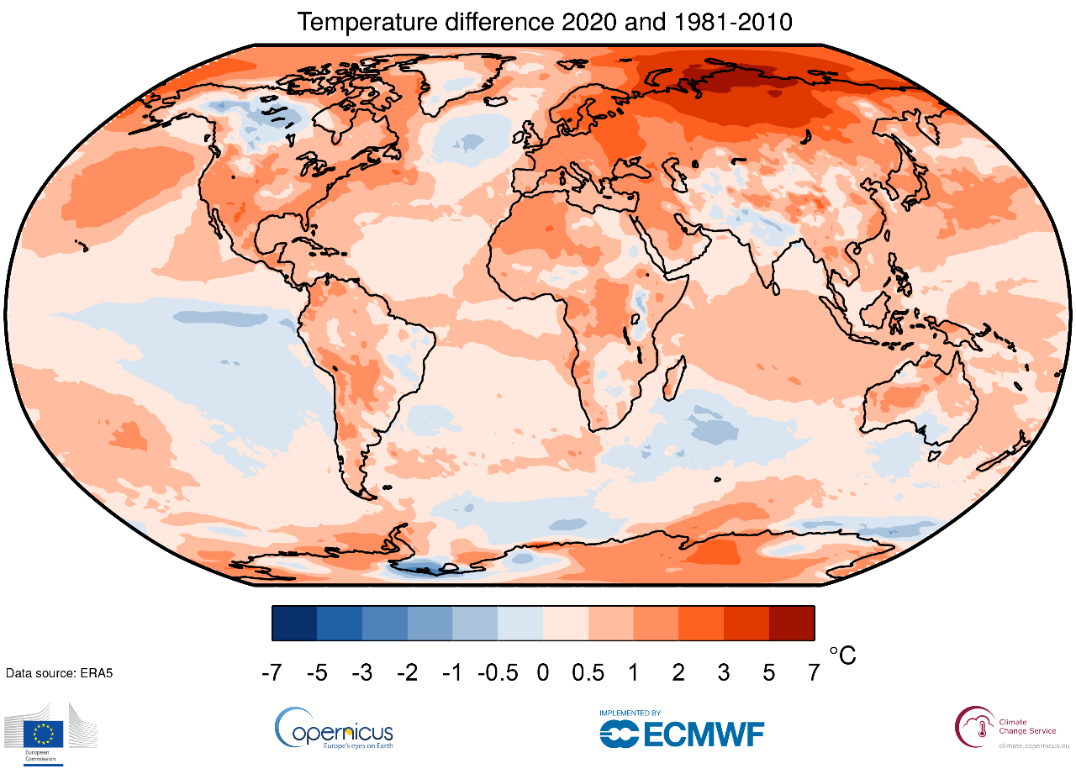
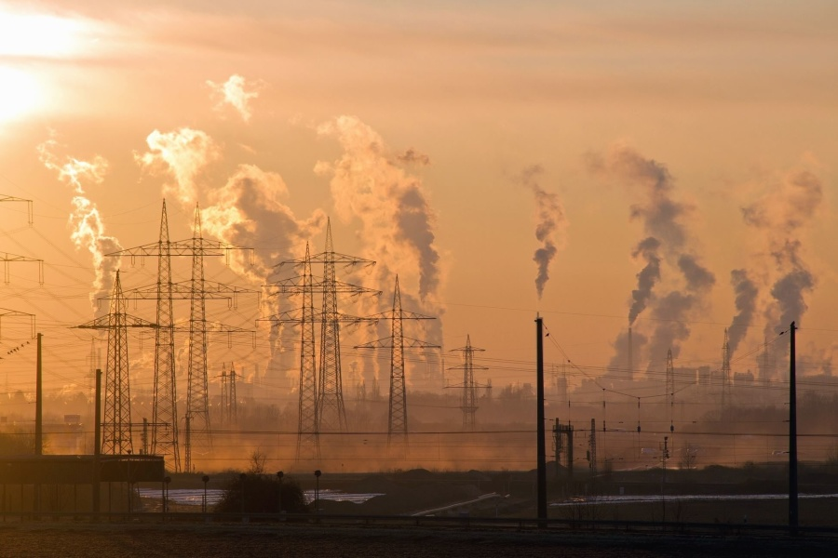
Humans have been changing climate
Photo: Wikimedia Commons, Map: ERAS

Slide 4
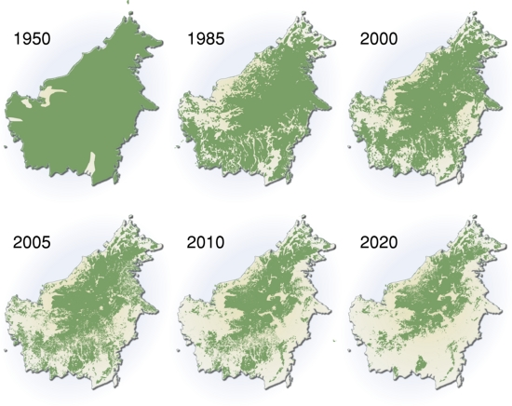
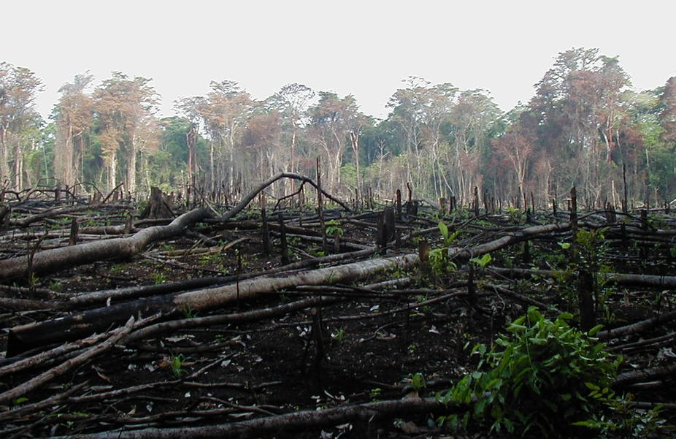
Humans dramatically affect land use
Deforestation of Borneo
Photo: Wikimedia Commons, Maps: UNEP

Slide 5
Maps of forest change at 30 m resolution
Hansen et al. (2013) Science

Slide 6
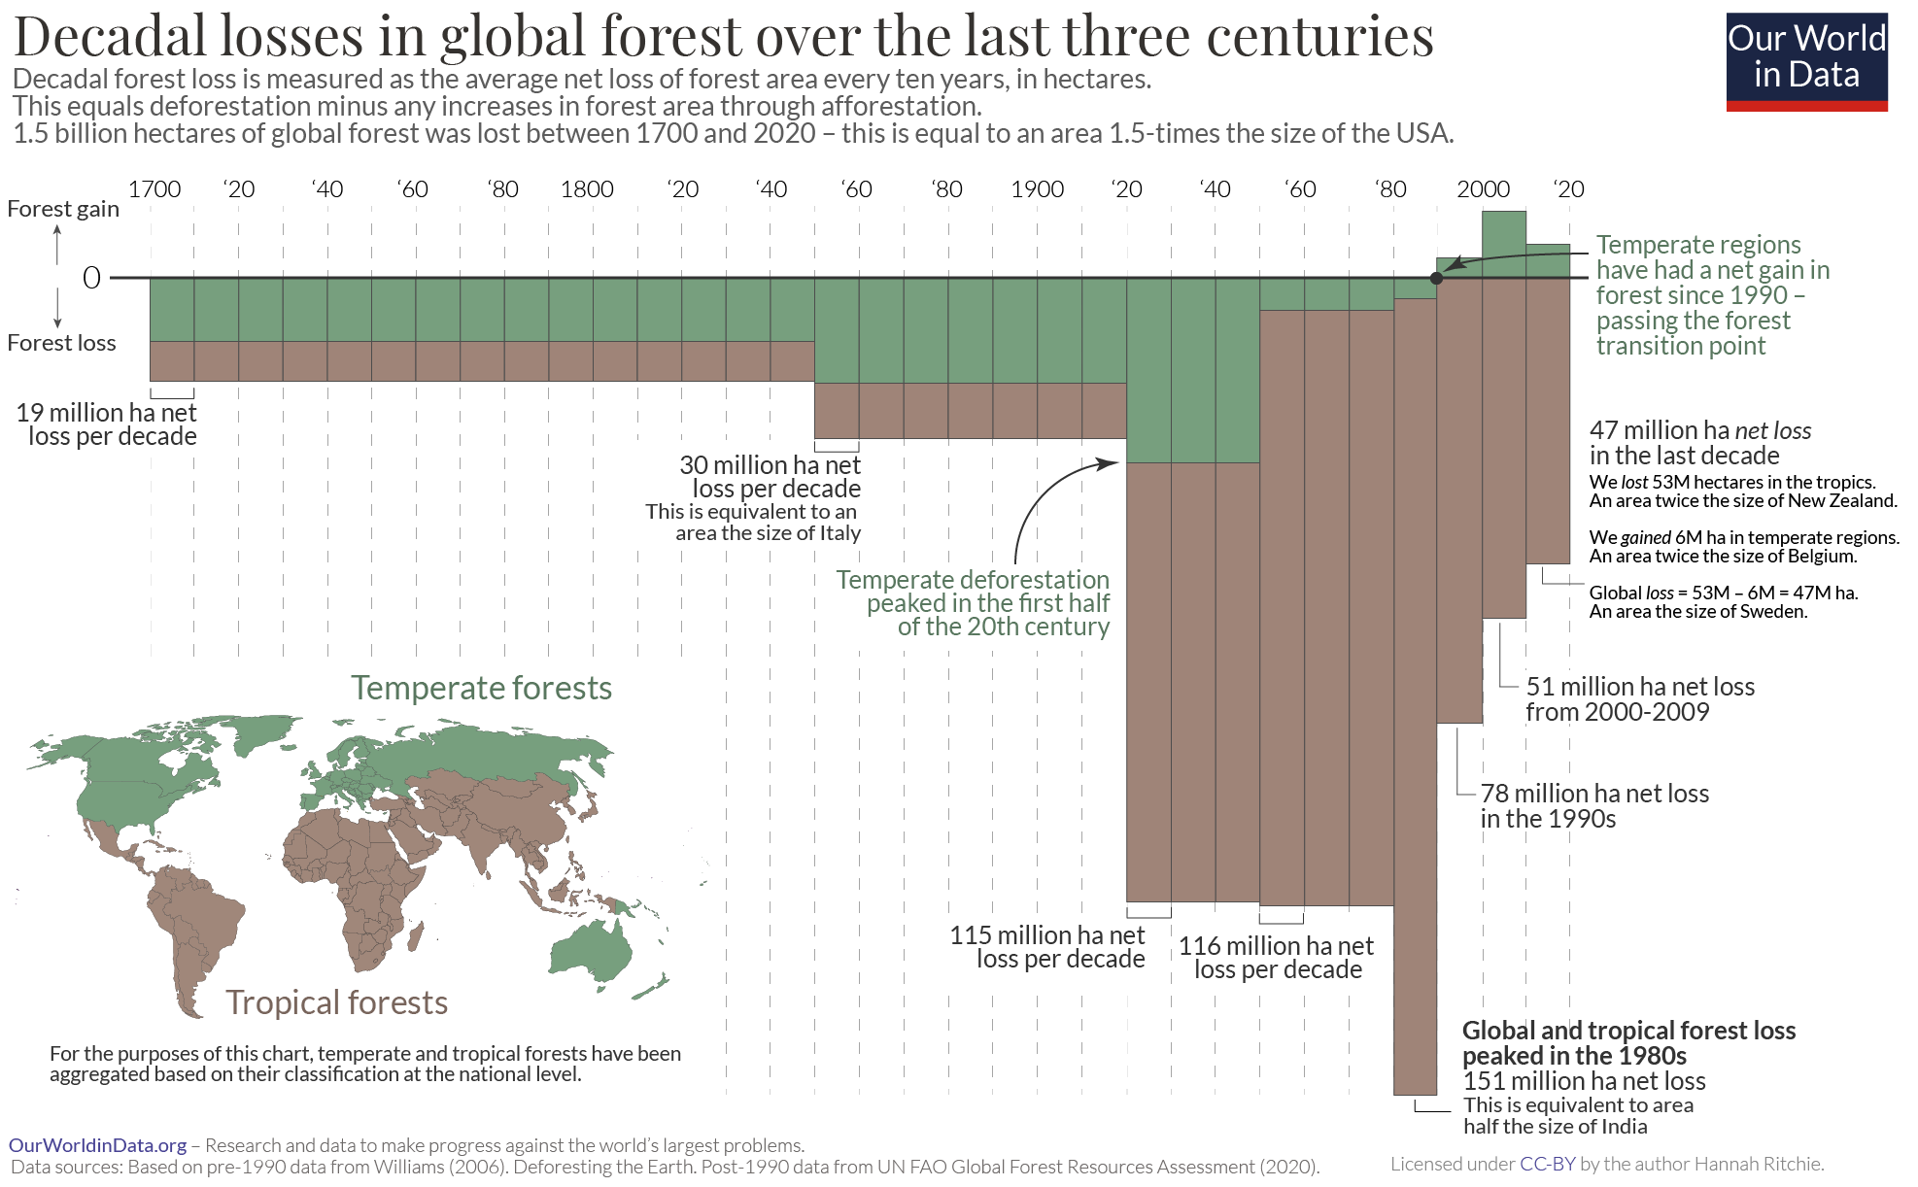
Global deforestation

Slide 7
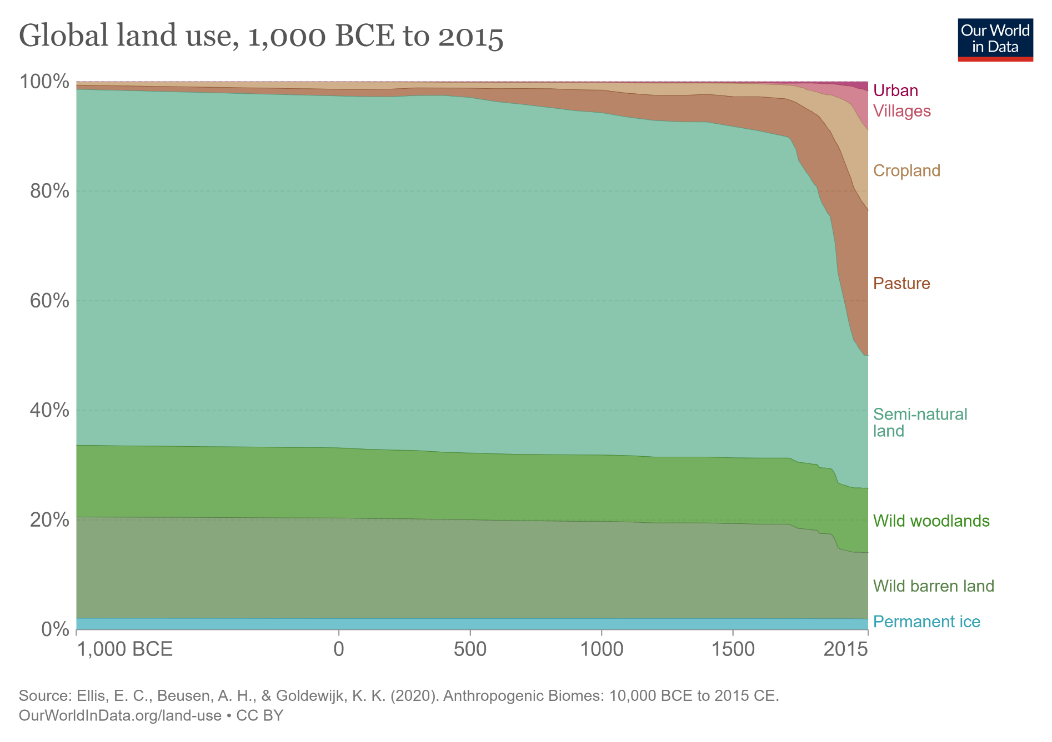
Global land use change

Slide 8
Effect of land use on species richness and abundance
Overall, land use intensity, agriculture, and urbanization decrease biodiversity, compared to adjacent natural areas or habitats.
Newbold et al. (2015) Nature

Slide 9

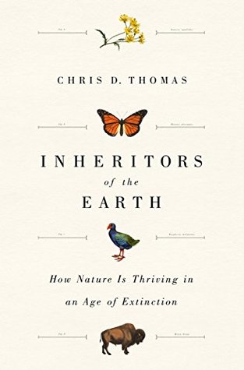
Given all the human-made pressures, are we in the midst of a biodiversity crisis?
IPBES (2019). Schiper et al. (2008) Science. Pereira et al. (2010) Science. Barnosky et al. (2012) Nature. Pimm et al. (2014) Science. Cowie et al. (2022) Biological Reviews.

Slide 10
Main review reports
How is biodiversity coping with all the environmental change?
What are its actual measured temporal trends?

Slide 11
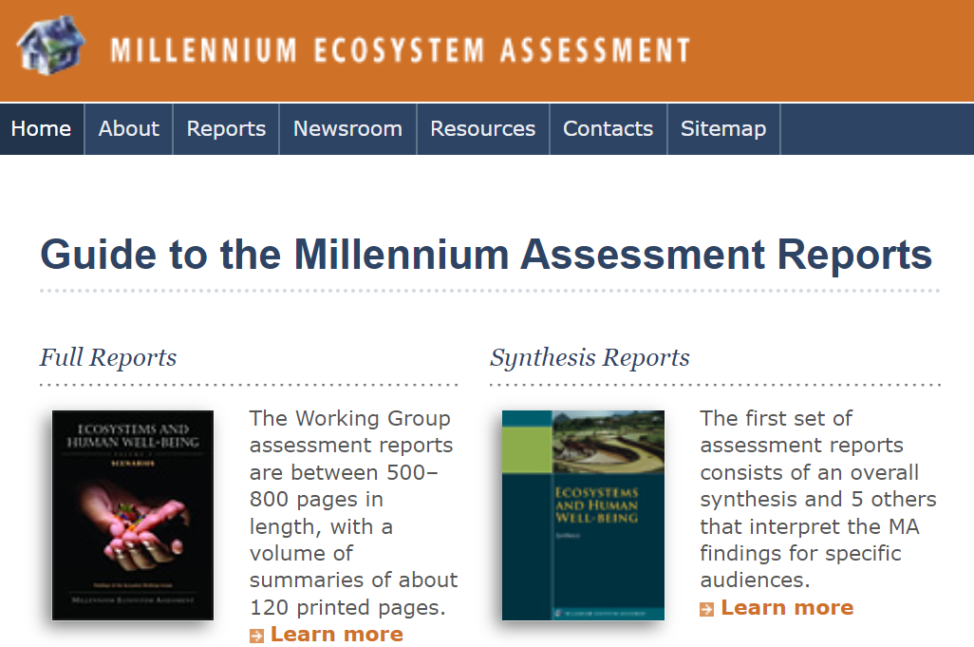
Millenium Ecosystem Assessment (2001-2005)

Slide 12
Global IPBES assessment (2010-present)
Inspired by IPCC (https://www.ipcc.ch/)
2010 - Initial impulse by United Nations General Assembly
2013 – first plenary initiated
2019, 2020, 2021 – the IBPES assessment report
IPBES (2019): Global assessment report on biodiversity and ecosystem services of the Intergovernmental Science-Policy Platform on Biodiversity and Ecosystem Services. E. S. Brondizio, J. Settele, S. Díaz, and H. T. Ngo (editors). IPBES secretariat, Bonn, Germany. 1148 pages. https://doi.org/10.5281/zenodo.3831673
IPBES (2019): Summary for policymakers of the global assessment report on biodiversity and ecosystem services of the Intergovernmental Science-Policy Platform on Biodiversity and Ecosystem Services. S. Díaz, J. Settele, E. S. Brondízio, H. T. Ngo, M. Guèze, J. Agard, A. Arneth, P. Balvanera, K. A. Brauman, S. H. M. Butchart, K. M. A. Chan, L. A. Garibaldi, K. Ichii, J. Liu, S. M. Subramanian, G. F. Midgley, P. Miloslavich, Z. Molnár, D. Obura, A. Pfaff, S. Polasky, A. Purvis, J. Razzaque, B. Reyers, R. Roy Chowdhury, Y. J. Shin, I. J. Visseren-Hamakers, K. J. Willis, and C. N. Zayas (eds.). IPBES secretariat, Bonn, Germany. 56 pages. https://doi.org/10.5281/zenodo.3553579

Slide 13
Example graphics from IPBES report: Global species loss
IPBES (2019)
Ceballos et a. (2015) Science Advances

Slide 14
Example graphics from IPBES report: Overall trends in simple accessible summary
IPBES (2019)

Slide 15
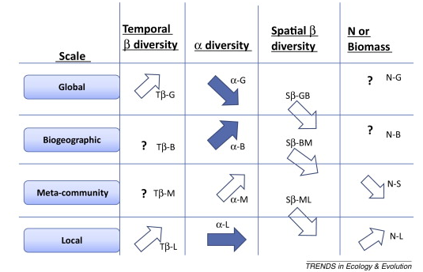

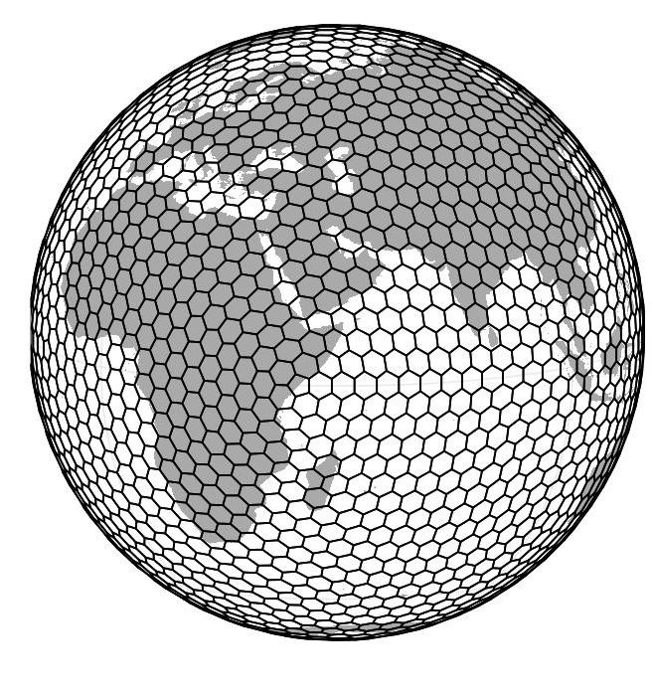

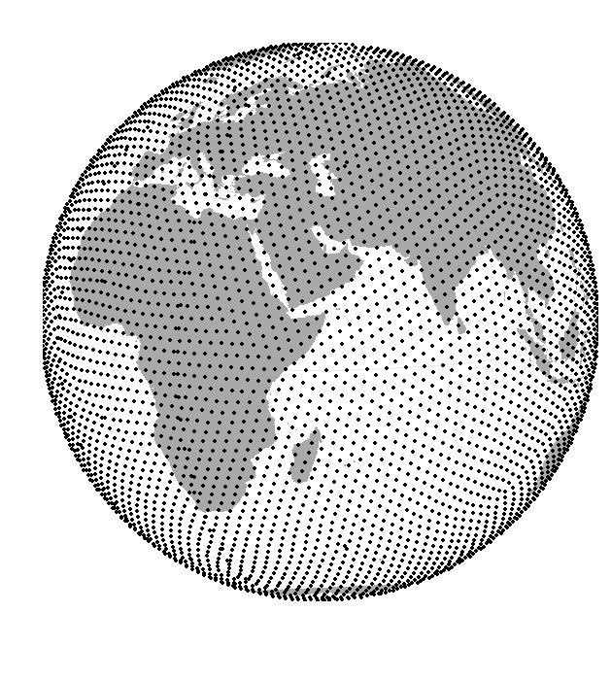
Another good review of various types of trends: McGill et al. 2015
McGill et al. (2015) Trends in Ecology and Evolution

Slide 16
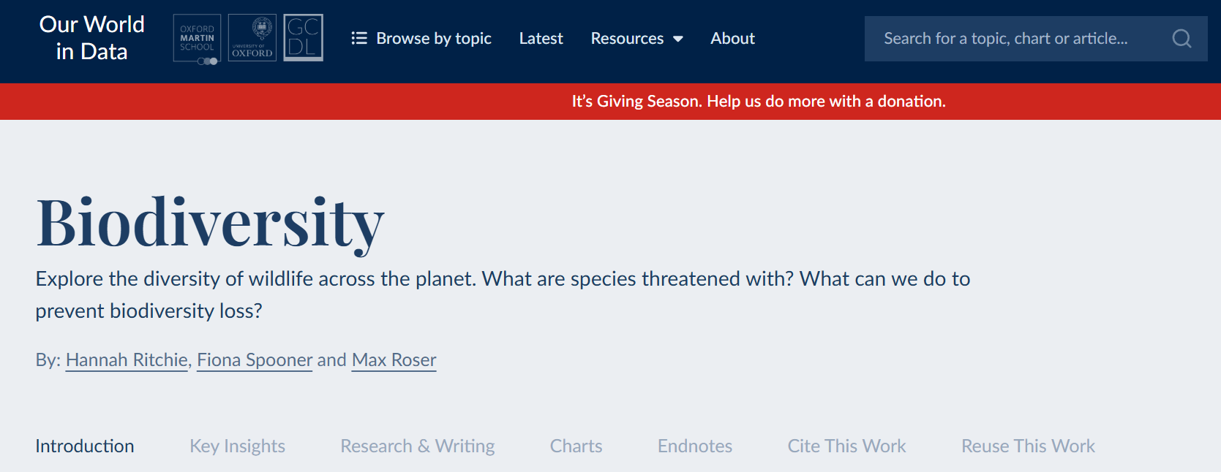
Is ourworldindata.org a good summary/source?

Slide 17
Population changes
How have numbers of individuals, densities, or biomass been changing in the Anthropocene?

Slide 18
Living Planet Report 2022 – attempt to summarize populations trends
WWF & ZSL (2022)
https://livingplanet.panda.org/

Slide 19
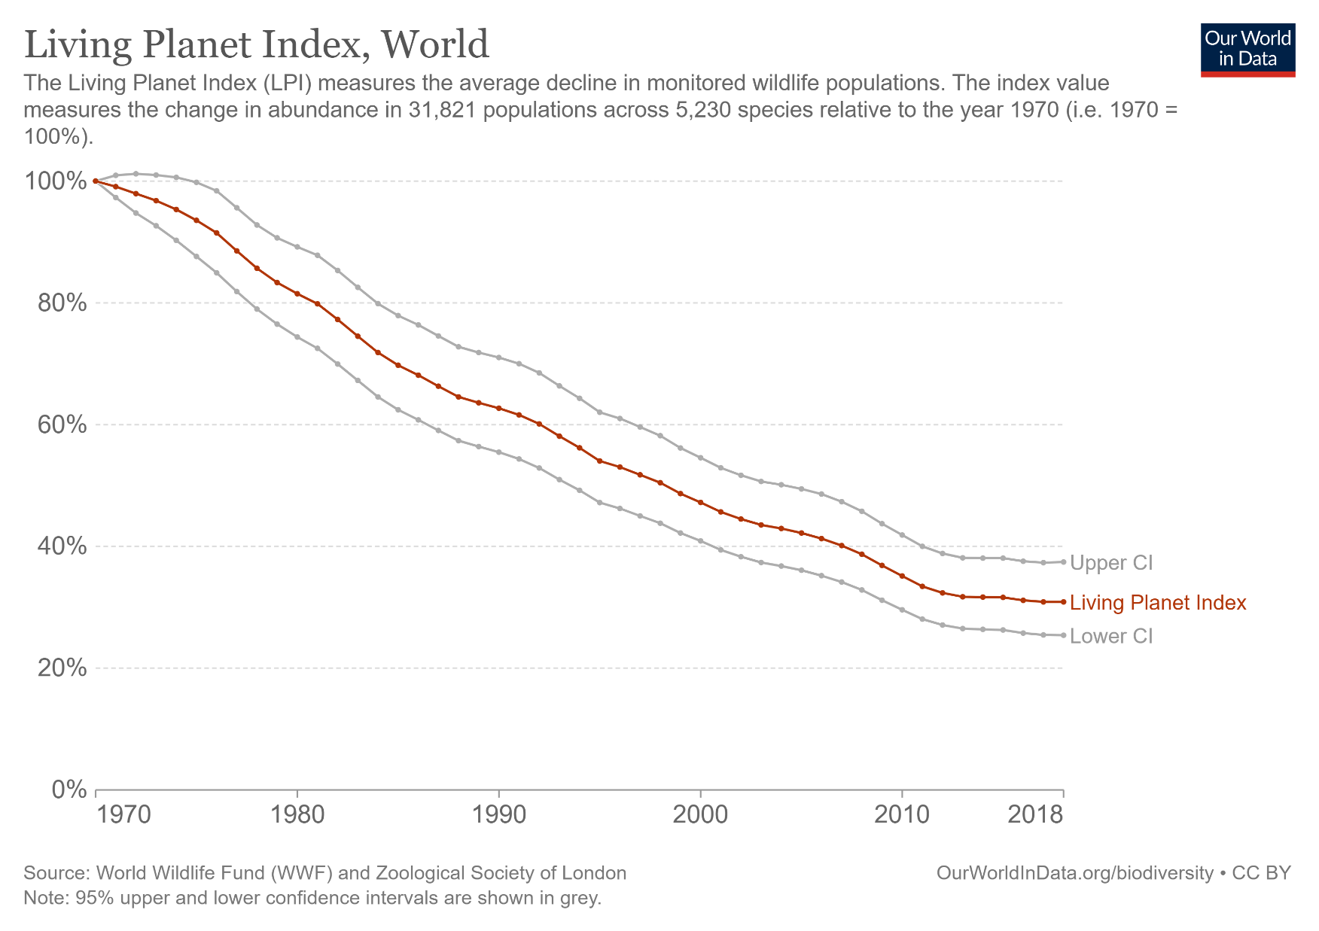
Living Planet Index (LPI) – summarizing all trends in a single average metric
WWF & ZSL (2022)

Slide 20
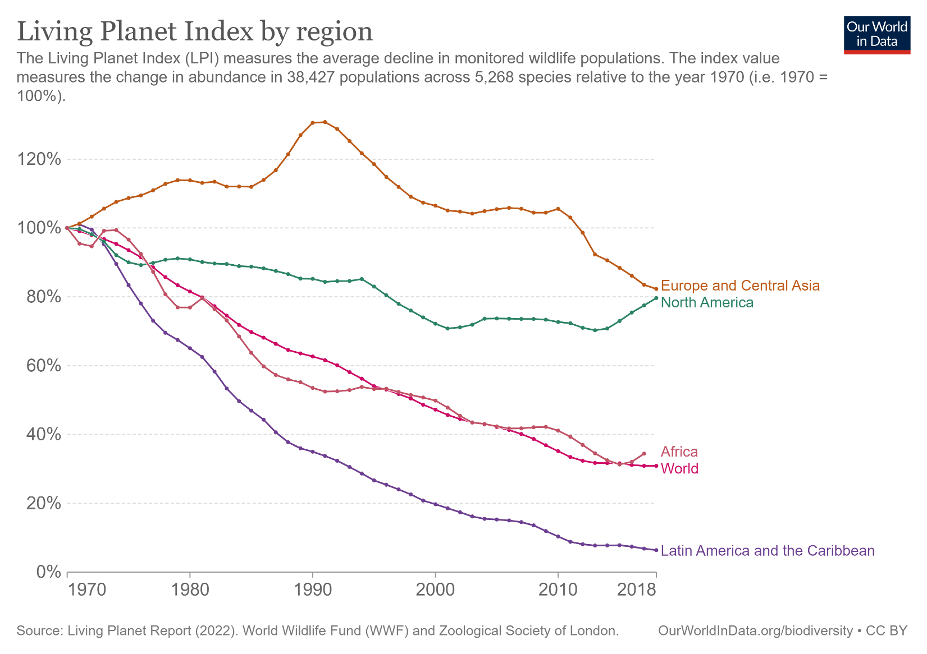
Living Planet Index (LPI) – decomposing the metric by continents
WWF & ZSL (2022)

Slide 21
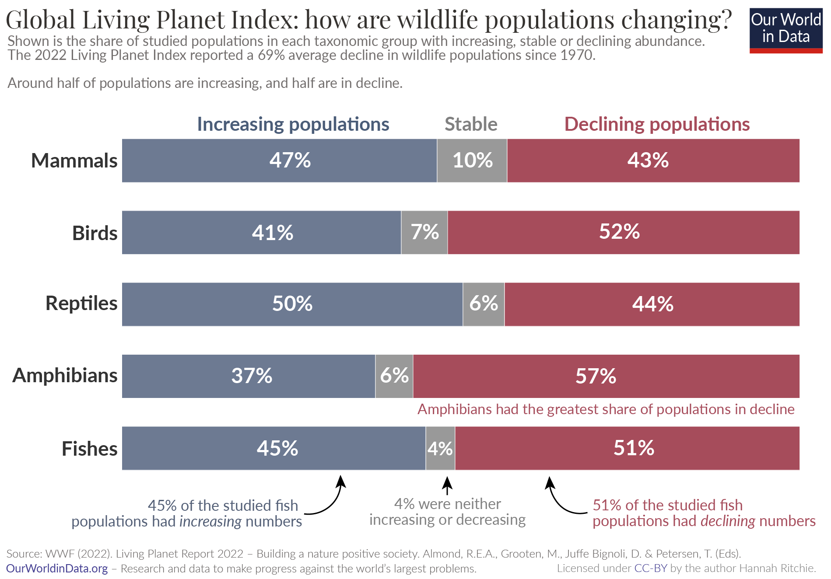
Living Planet Index (LPI) – decomposing the trends by major vertebrate taxa
WWF & ZSL (2022)

Slide 22
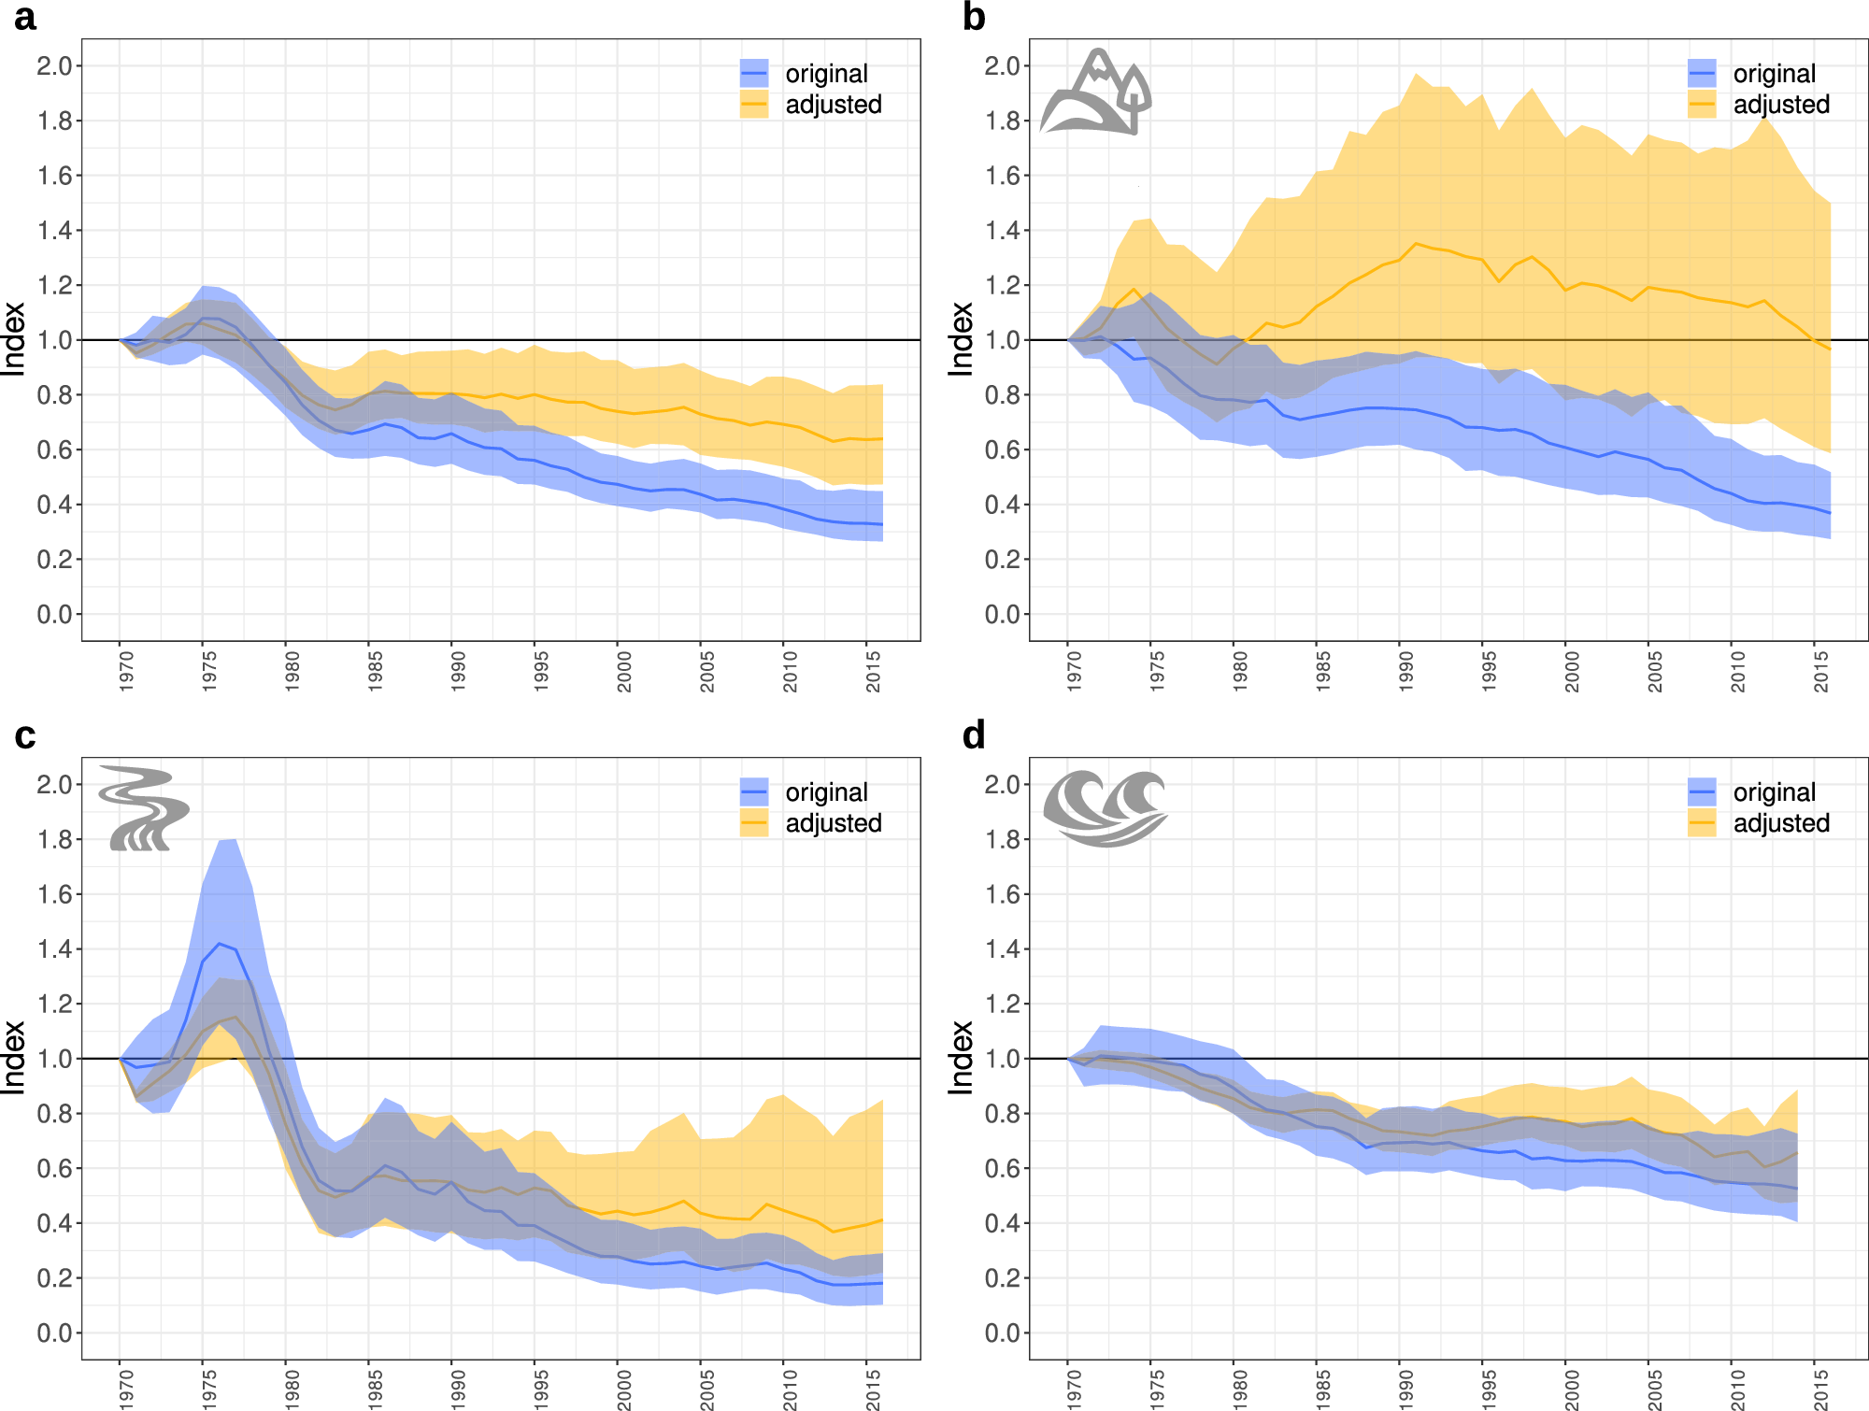

LPI is also mathematically flawed (multiple times)
Dr. Anna Toszogyová
Center for Theoretical Study, Prague
Toszogyova et al. (2024) Nature Communications

Slide 23
There has been a lively debate in Nature on the relevance of LPI

Slide 24
Leung et al. (2020) argue that the LPI decline is driven by less than 3% of populations
Leung et al. (2020) Nature

Slide 25
The complex geography of population trends
Terrestrial populations
Marine populations
Freshwater populations
Leung et al. (2020) Nature

Slide 26
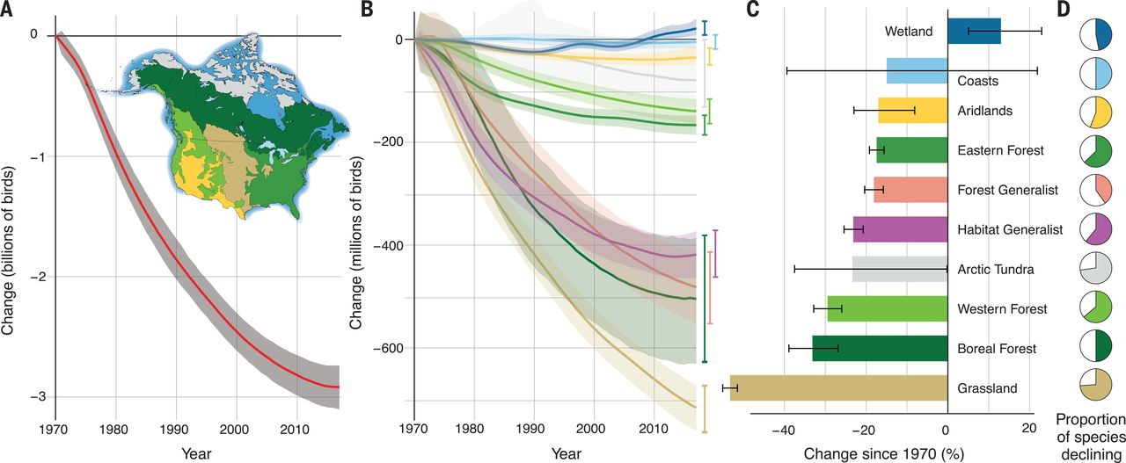
Bird population declines in the United States
Rosenberg et al. (2019) Science

Slide 27
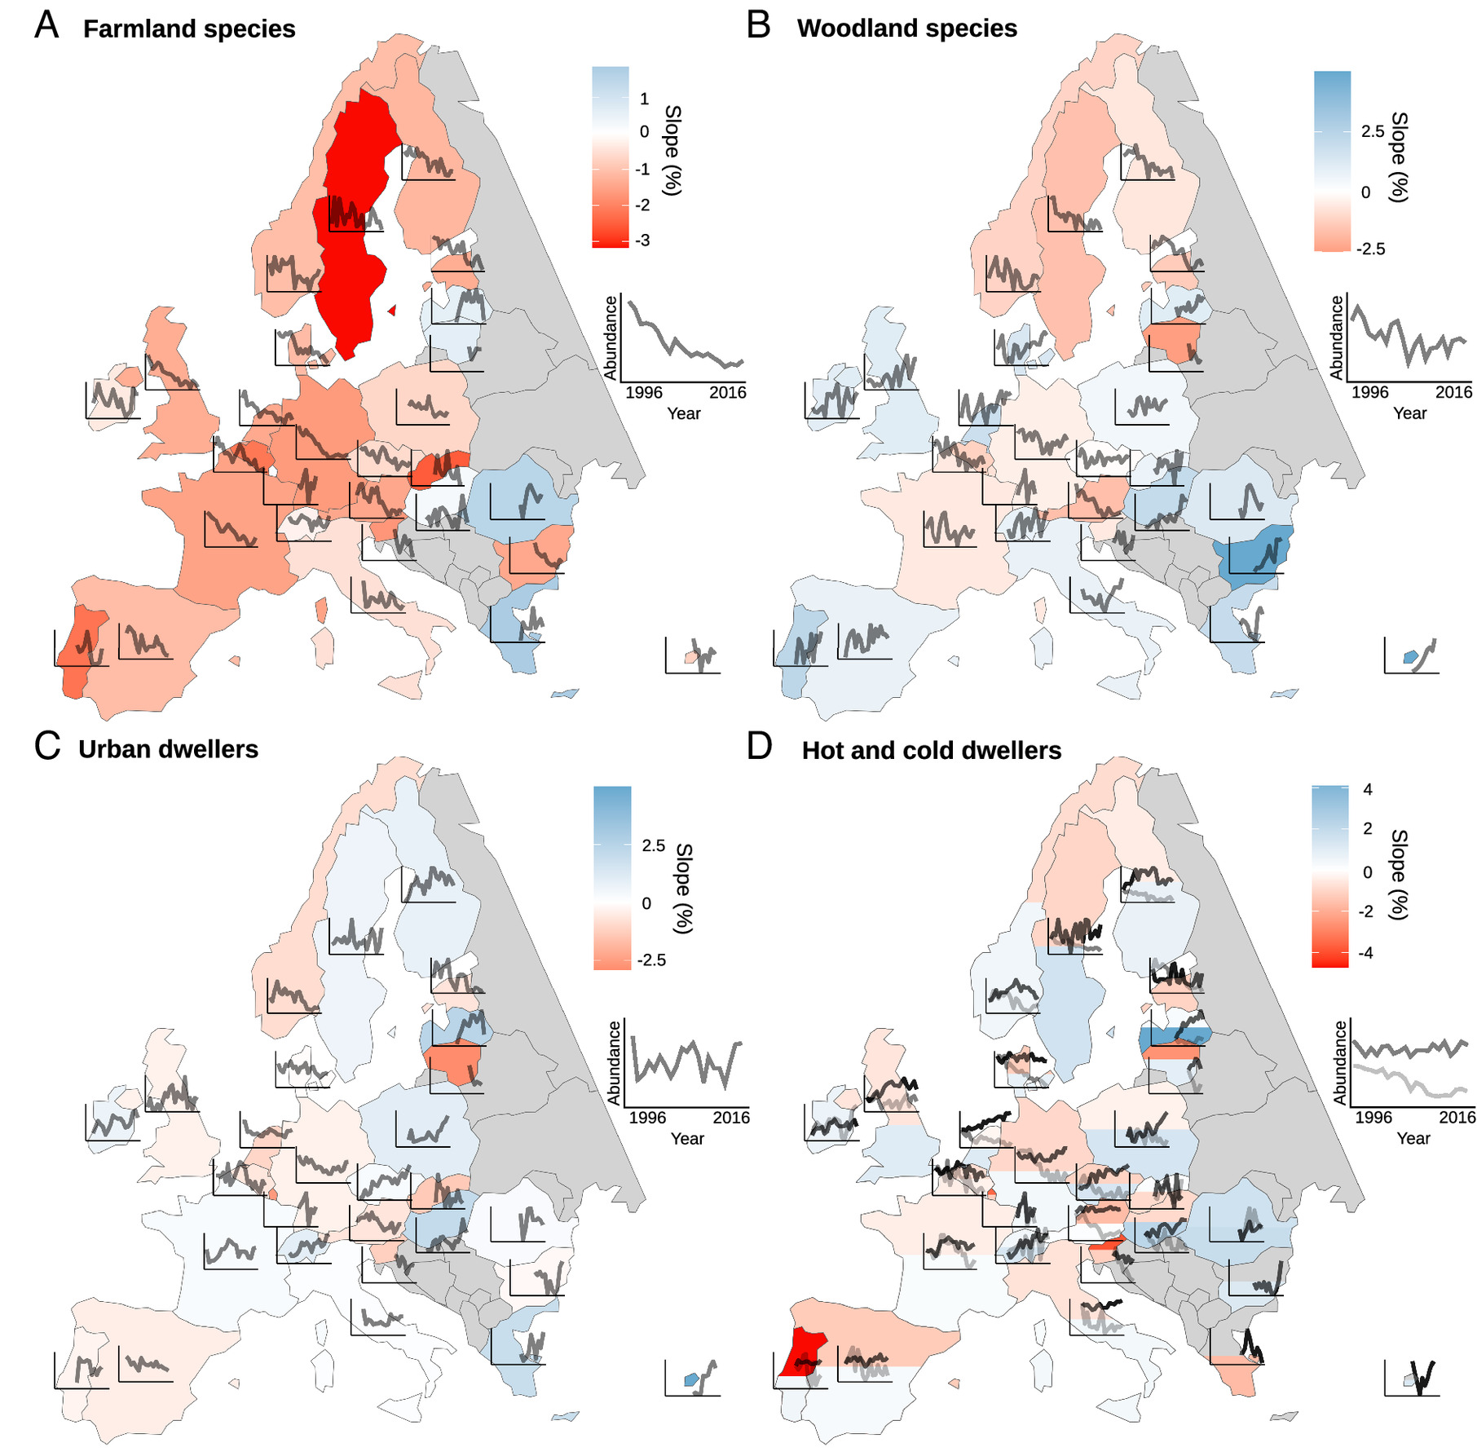
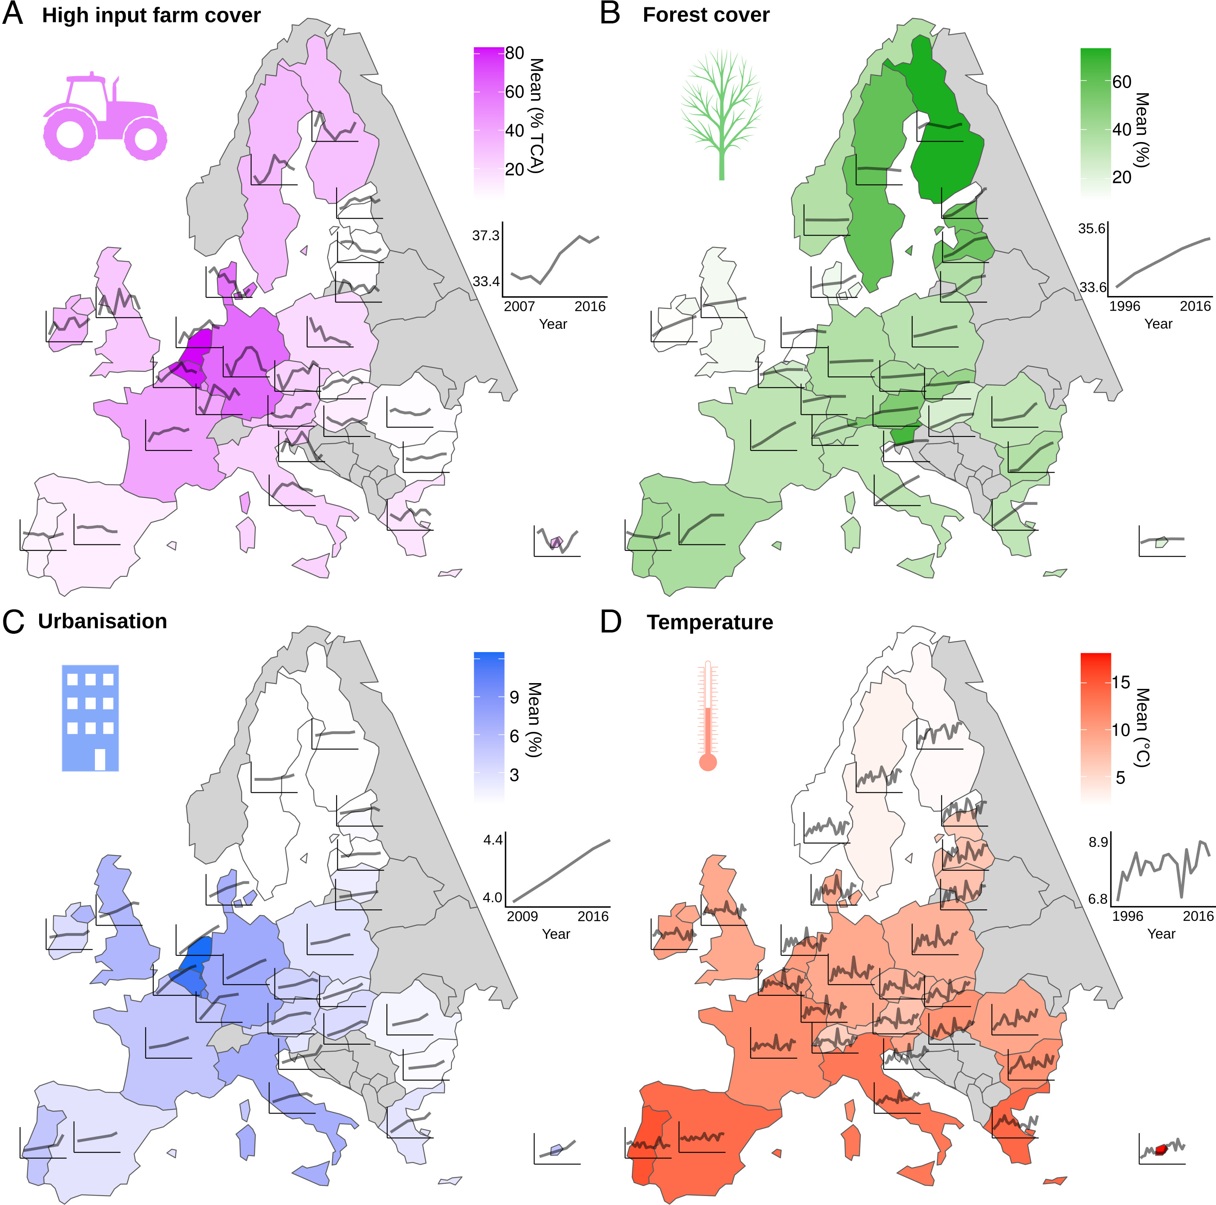
Bird population changes in Europe
Rigal et al. (2023) PNAS

Slide 28
An illustrative story of Czech birds
Forest birds
We observe decreases of population indices in farmland birds, but increases in forest birds
Reif et al. (2007) Bird Study
Reif & Vermouzek (2019) Conservation Letters

Slide 29
Insect armagedon

Slide 30
The paper that started it all …
Hallmann et al. (2017) PLOS One
Notes:
- But it is not as simple.
- There have been studies looking at thousands of time series from local communities. Surprisingly, on average, we see no net change of species richness.
- So we have global extinctions, but no decline of local biodiversity?
- How is that possible?
First, there are sampling issues and a lack of local data in most regions, which can cause the mismatch between local and global
Second, different studies use different metrics. For example, decline of species richness is not the same as extinction

Slide 31
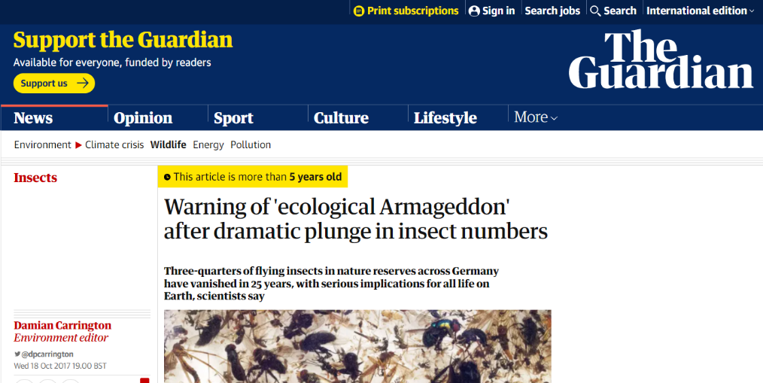
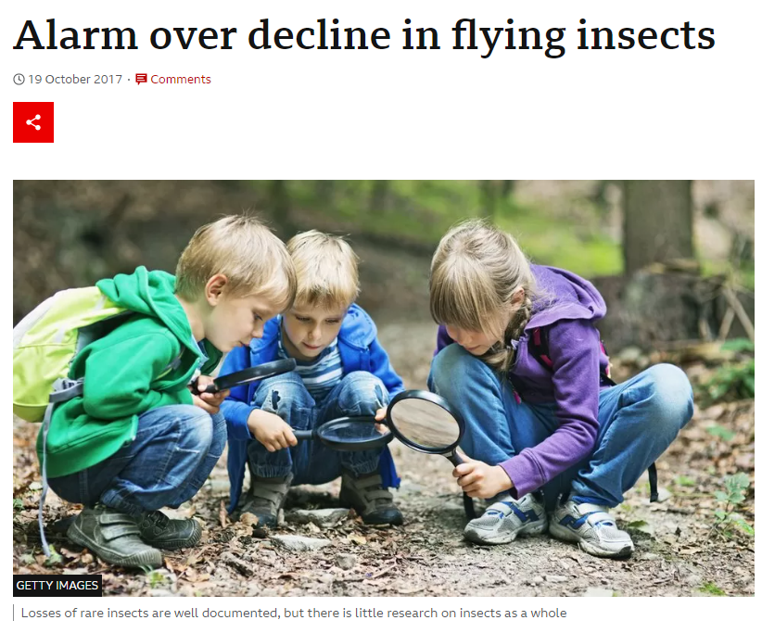

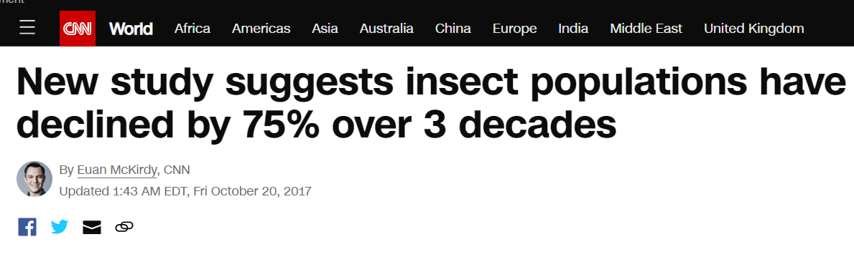
… and the reaction in media
Hallmann et al. (2017) PLOS One

Slide 32
Malaise traps in 63 nature protection areas in Germany
Hallmann et al. (2017) PLOS One

Slide 33

Roel van Klink’s response: Analysis of 1676 sites globally
van Klink et al. (2020) Science

Slide 34
Roel van Klink’s response: Analysis of1676 sites globally
Van Klink et al. (2020) Science

Slide 35
Species richness change, loss, and gain

Slide 36
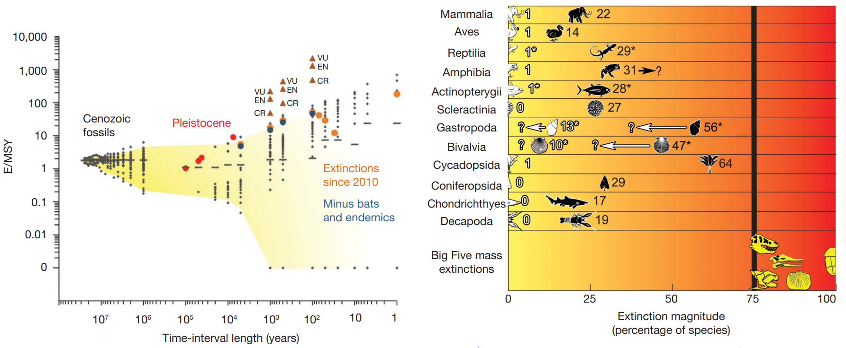
The article that everyone cites …
Barnosky et al. (2011) Nature

Slide 37
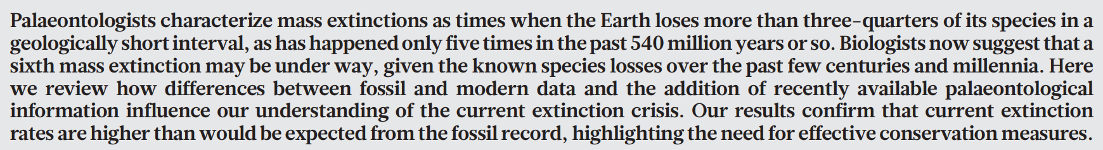
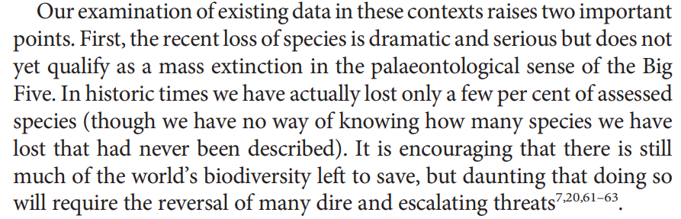
The article that everyone cites …
The abstract:
The conclusions:
Barnosky et al. (2011) Nature

Slide 38
… but, no net decline of species richness in local plant communities
Vellend et al. (2013) PNAS

Slide 39
No net decline of species richness in local plant communities
Vellend et al. (2013) PNAS

Slide 40
No net decline of species richness in local plant communities
Jandt et al. (2022) Nature

Slide 41
No net decline of species richness in local communities
Dornelas et al. (2015) Science, Dornelas et al. (2017) GEB

Slide 42
No net decline of species richness in local communities
Dornelas et al. (2014) Science, Dornelas et al. (2017) GEB

Slide 43
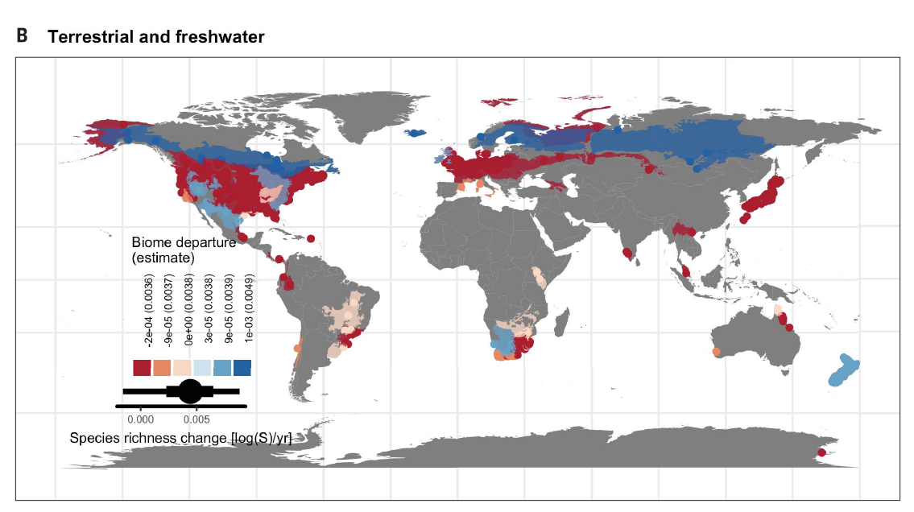
No net decline of species richness in local communities
Blowes et al. (2019) Science

Slide 44
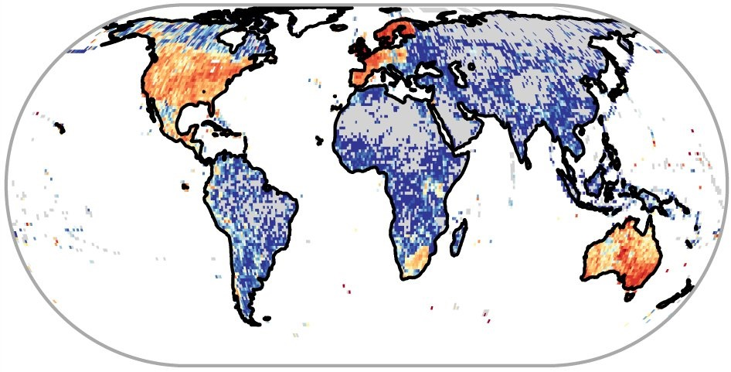
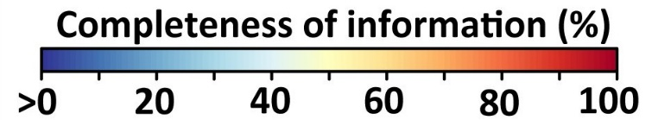
Why no change of local richness, if we think that things should be going bad?
Spatial, temporal, but also taxonomic gaps and biases
There is massive geographic bias towards the rich Global North, accessible areas, etc.
Meyer et al. (2015) Nature Communications

Slide 45
Sampling problem – Spatial gaps and biases in biodiversity data
Dornelas et al. (2015) Science, Dornelas et al. (2017) GEB

Slide 46
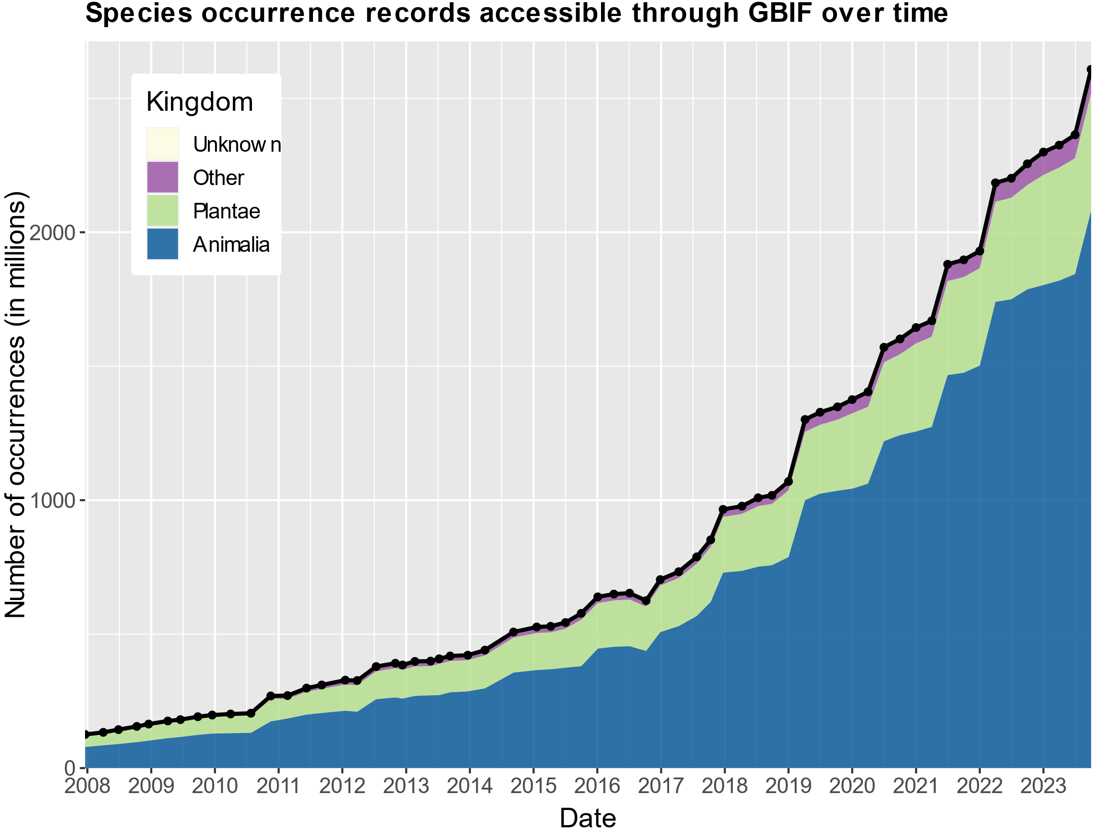
Temporal bias
https://www.gbif.org/analytics/global

Slide 47
Why no change of local richness, if we think that things should be going bad?
Too many concepts, indices, and indicators (of loss). Population declines, extinction risk, number of extinctions, range contractions, per-species extinction rate, and decline of species richness are related but different things.
The problem of shifting baselines – maybe things were already bad at the start of the time series, and so we are not seeing the main change because it happened long ago
Alpha, beta, gamma, functional, genetic, diversity, abundance-based vs incidence-based, …
Most time series from natural or semi-natural habitats (not from parking lots, clearings)
Sampling issues ignored – imperfect detection of presence, absence, loss and gain (it is difficult to prove that something has disappeared)
We fail to detect the loss of rare species, because they are … rare
Biodiversity change is grain-dependent

Slide 48
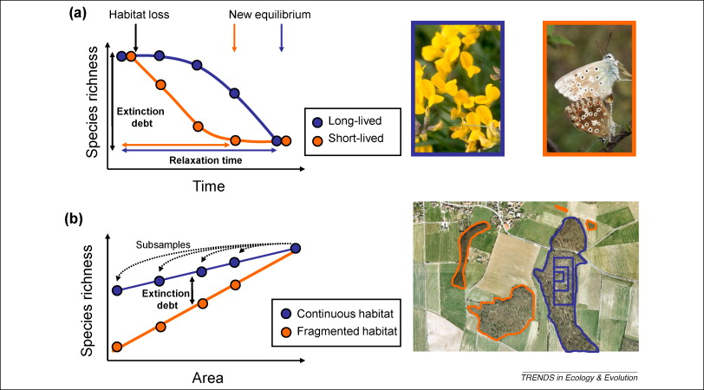
Extinction debt
Local extinction of species can occur with a substantial delay following habitat loss or degradation. Accumulating evidence suggests that such extinction debts pose a significant but often unrecognized challenge for biodiversity conservation across a wide range of taxa and ecosystems.
Kuussaari et al. (2009) Trends in Ecology and Evolution

Slide 49
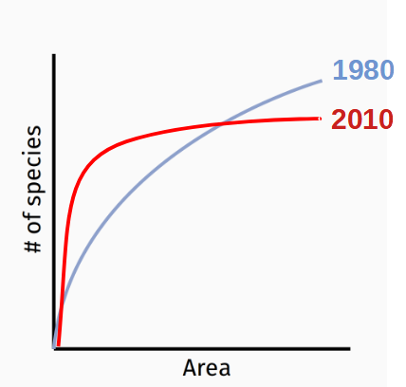

Scale problem - Biodiversity change is grain dependent
decrease
increase
Keil et al. (2011) Ecography
Powell et al. (2013) Science

Slide 50
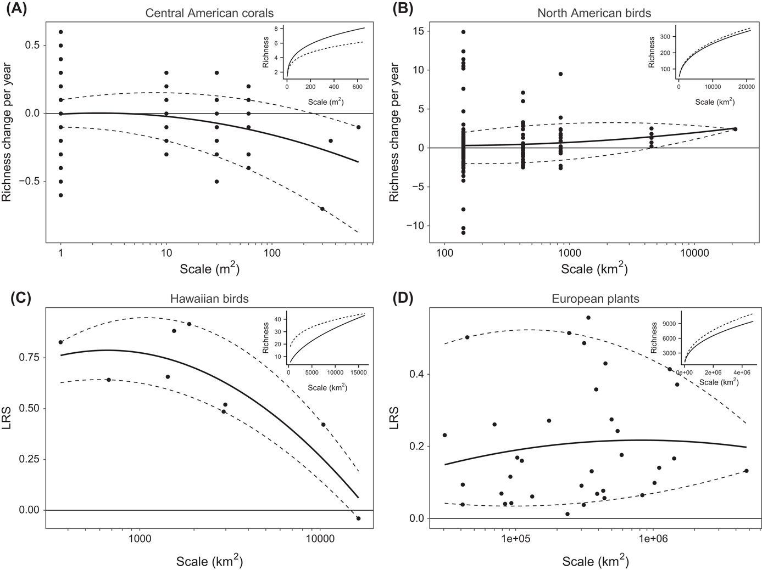
Scale problem - Biodiversity change is grain dependent
Chase et al. (2019) Oikos

Slide 51

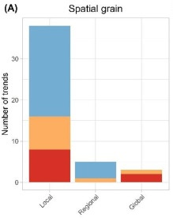
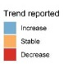
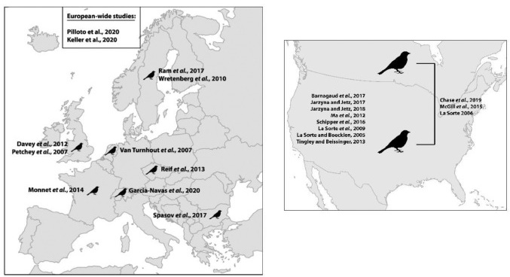
Scale problem - Biodiversity change is grain dependent
Francois Leroy
Leroy et al. (2023) Basic and Applied Ecology
51

Slide 52
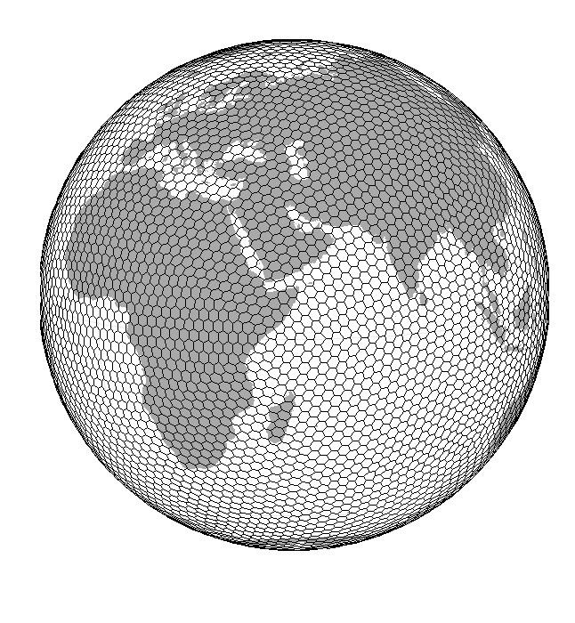

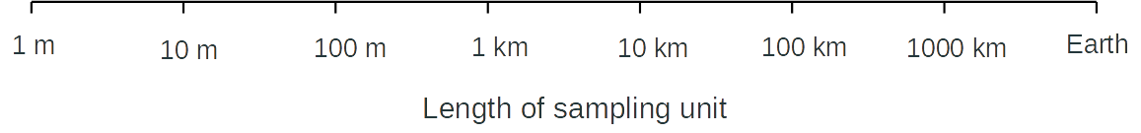
Scale problem - Biodiversity change is grain dependent
Spatial Grain [length of spatial unit]

Slide 53
Change of species composition
Why no net change of species richness can still mean substantial changes

Slide 54
Pairwise similarity between sites
Similarity
1
1
1
1
1
Sites
1
1
1
1
1
1
1
1
1
1
Sites
Species
1
1
1
1
1
1
1
1
1
1
Sites
Species
1
1
1
1
1
Species

Slide 55
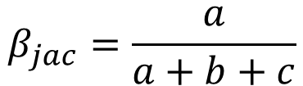
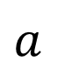
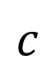
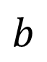
Pairwise similarity between sites
$$β_{jac}=\frac{a}{a+b+c}$$
$$b$$
1
1
1
1
1
Sites
1
1
1
1
1
$$a$$
Species
$$c$$
Legendre & Legendre (2012) Numerical Ecology
Koleff et al. (2003) J. Anim. Ecol.

Slide 56
Even if richness is stable, composition changes
As time goes, communities become more and more dissimilar from the initial state.
This is a “temporal decay” of compositional similarity.
But without a comparison with some “good” scenario, we don’t know if it’s good or bad
Fig. 2 Temporal change in α diversity and temporal β diversity.
(A and B) Temporal change in species richness (A) and species composition (B) as measured by Jaccard similarity between each sample and the first sample in the time series. Data points are represented by gray circles and models fitted by solid lines. The black line corresponds to a model in which a single slope, but different intercepts, were fitted to all the time series, and is represented here with the mean intercept. The colored lines correspond to a model where each time series had a different slope and intercept. Color coding corresponds to Fig. 1. Figure S10 presents a similar analysis for a different approach to rarefaction.
Dornelas et al. (2014) Science, Dornelas et al. (2017) GEB

Slide 57
Biotic homogenization vs differentiation
Low beta diversity
High beta diversity
Homogenization
Low beta diversity
Differentiation

Slide 58

Species spreads, invasions, and extinctions as the driving force of homogenization
Low beta diversity
High beta diversity
Homogenization
Low beta diversity
Differentiation

Slide 59
Species spreads, invasions, and extinctions as the driving force of homogenization
Olden et al. (2011) Chapter in Conservation Biogeography

Slide 60
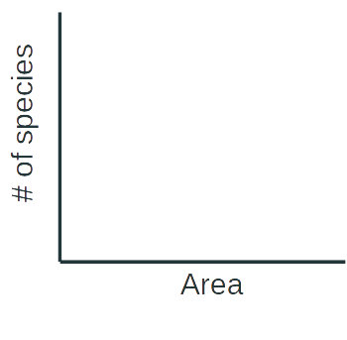
We can measure homogeneization using beta, alpha, and gamma, or SAR
γ
(S)
Slope of SAR is proportional to beta diversity. The steeper the SAR, the higher beta diversity.
α
β=γ/α
log
log
(A)
High beta diversity
Low beta diversity
The slope of SAR (beta diversity) reflects species spatial aggregation.
γ
γ
α
α

Slide 61
Species spreads, invasions, and extinctions as the driving force of homogenization
Winter et al. (2009) PNAS

Slide 62
Most recent study: Biotic homogenization as common as differentiation (or slowing down)
Regional diversity change
Local diversity change
Blowes et al. (2023) BioArXiv
Carvalhiero, Kunin, Keil et al. (2013) Ecology Letters

Slide 63
Summary

Slide 64
Given all the human-made pressures, are we in the midst of a biodiversity crisis?
IPBES (2019). Schiper et al. (2008) Science. Pereira et al. (2010) Science. Barnosky et al. (2012) Nature. Pimm et al. (2014) Science. Cowie et al. (2022) Biological Reviews.

Slide 65
The big picture
We know that with growing human population the pressure on nature increases.
Climate changes, land use changes, populations and ecosystems are exploited
Yet the empirical data tell a nuanced and complex story. Population abundances and species richness show variable temporal trends, there is a lot of local context, and although more areas deteriorate, other areas improve, or the good/bad of the trend cannot be clearly identified
Also, composition changes considerably, irrespectively to diversity changes, and there is both homogeneization and differentiation
How is that possible?
Likely due to complex nature of the drivers, but also the data are geographically, taxonomically, and environmentally biased.

Slide 66
Thank you. Questions?

